Slide 1
Binary Search Tree (BST) (Balancing, Successor, predecessor, Deletion)

Slide 2
Overview
Binary trees Ch 12.2–3
Trees Ch 10.4, 12.1

Slide 3
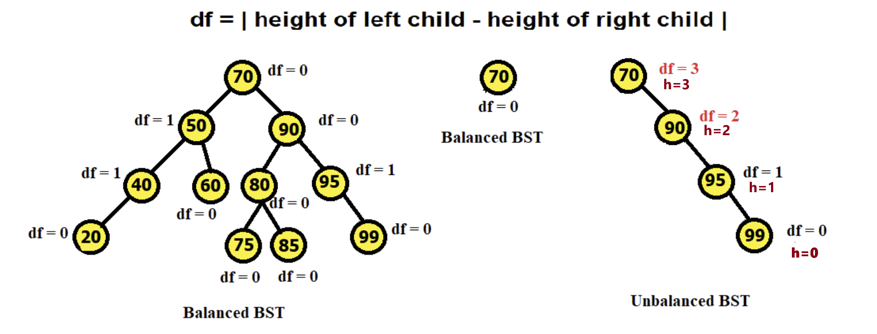
Balanced vs Unbalanced BST
If the height difference between the left and right subtrees of any node in the BST is more than one, it is considered unbalanced. Otherwise, it is balanced.
In a balanced BST, searching operations have a time complexity of O(log(n)).
In an unbalanced BST (when it starts to become skewed), searching may take up to O(n), rendering the BST inefficient.

Slide 4
Balanced vs Unbalanced BST
Maintaining Efficiency in BSTs (Importance of Balanced BST )
Always work with balanced BSTs to ensure optimal performance. - In balanced BST, insert, delete, search → O(h)→O(logn)
After insert or delete operations, height of BST might change, check if the BST has become unbalanced.
If unbalanced, rebalance the BST to restore efficiency.

Slide 5
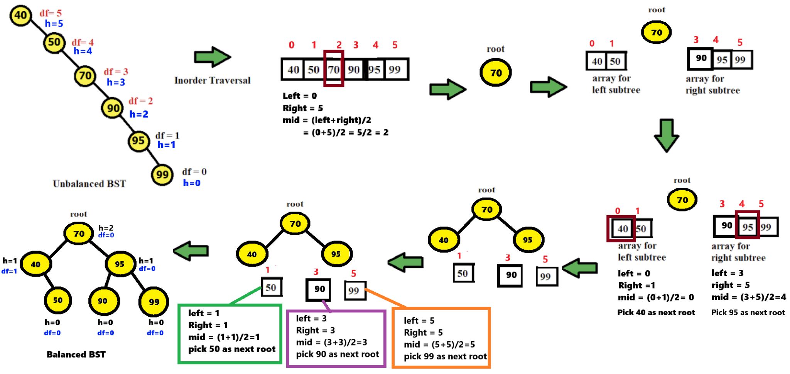
Converting an Unbalanced BST into a Balanced BST

Slide 6
Converting an Unbalanced BST into a Balanced BST
Step 1: Traverse and Store Data: perform Inorder Traversal → Store BST elements in ascending array.
Step 2: Reconstruct the BST: Choose the middle element using the current index bounds:
Compute mid = (left + right) // 2.
Create the root from arr[mid].
The left subtree uses the subarray from left to mid - 1.
The right subtree uses the subarray from mid + 1 to right.
Step 3: Recursive Subtree Construction
Base case: if left > right, return None.
Recursively build:
root.left = sortedArrayToBSTRecur(arr, left, mid - 1)
root.right = sortedArrayToBSTRecur(arr, mid + 1, right)
Repeat until all ranges are exhausted.
This process ensures the BST becomes balanced with optimal height.

Slide 7
Sorted Array to Binary Search Tree

Slide 8

Successor and predecessor
Defined in terms of order of in-order tree walk
Assume unique keys
Successor of x: the node with the smallest key greater than x.key
Predecessor of x: the node with the largest key smaller than x.key
Binary trees Ch 12.2–3

Slide 9
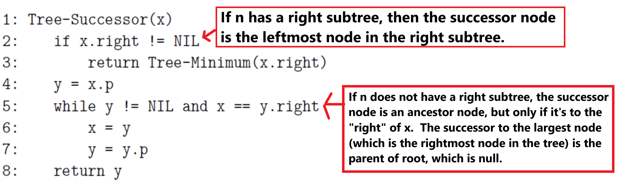
Tree Successor
Binary trees Ch 12.2–3

Slide 10
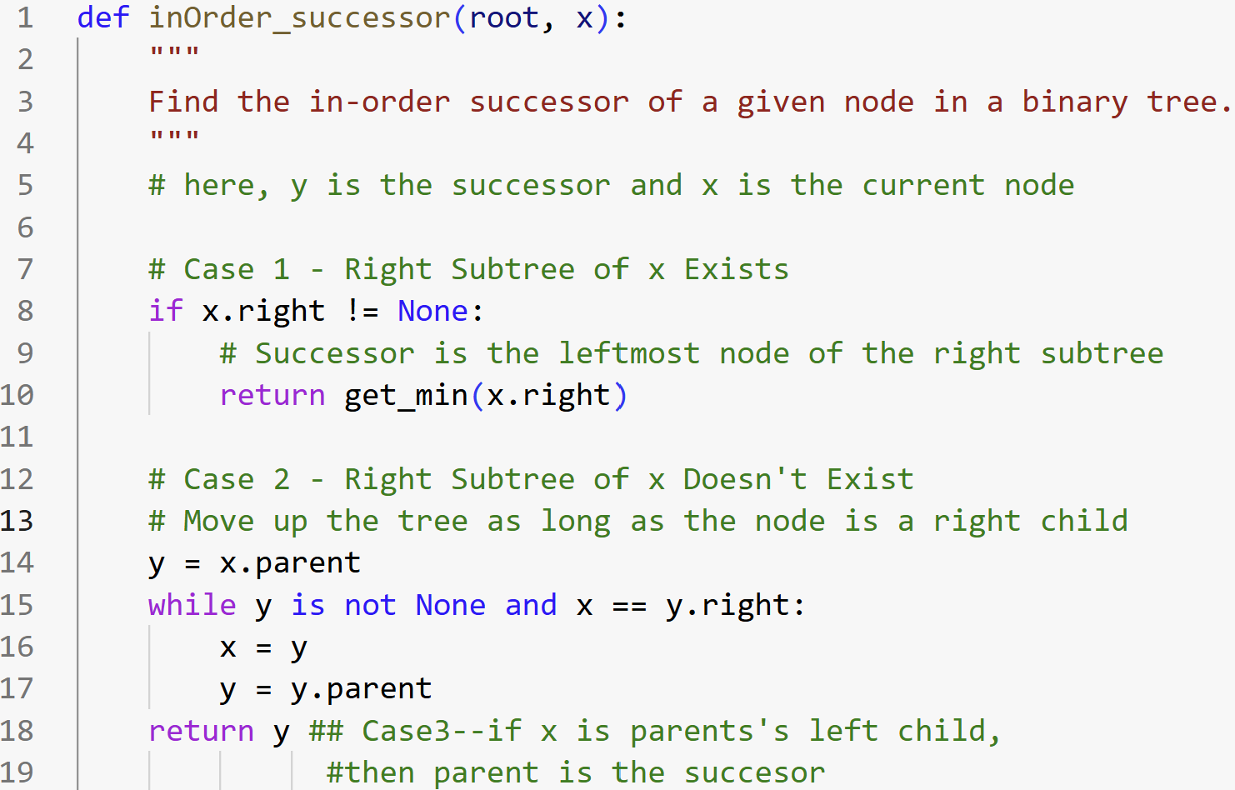
Tree Successor
Binary trees Ch 12.2–3

Slide 11
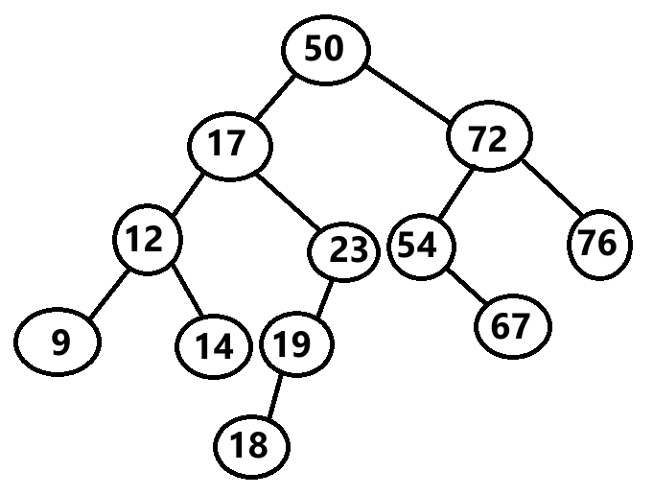
Successor
find successor(17) find successor(23) find successor(19) find successor(76)
Binary trees Ch 12.2–3

Slide 12
Successor
find successor(17): [Case01]
- right sub-tree exists
- get the leftmost node (min value) of the right subtree
- ans:18
find successor(23): [Case02]
- right sub-tree does not exist
- Loop: right child--Then, start going to the parent as long as it's the left child of its parents or y becomes Null.
- Here, x = current node, y=successor
- Step01: x(current)=23, y(successor)=17
- Step02: x(current)=17, y(successor)=50 (end of loop left branching--loop exits)
- ans:50
Binary trees Ch 12.2–3

Slide 13
Successor
find successor(19): [Case03]
- right sub-tree does not exist
- x is left child of parent --Then, the successor is the parent of 19 which is 23
- ans:23
find successor(76): [Case02]
- right sub-tree does not exist
- right child--Then, start going to the parent as long as left branching exists or y becomes Null.
- Here, x = current node, y=successor
- Step01: x(current)=76, y(successor)=72
- Step02: x(current)=72, y(successor)=50
- Step03: x(current)=50, y(successor)=None (y==None, loop will end)
- ans:None
Binary trees Ch 12.2–3

Slide 14
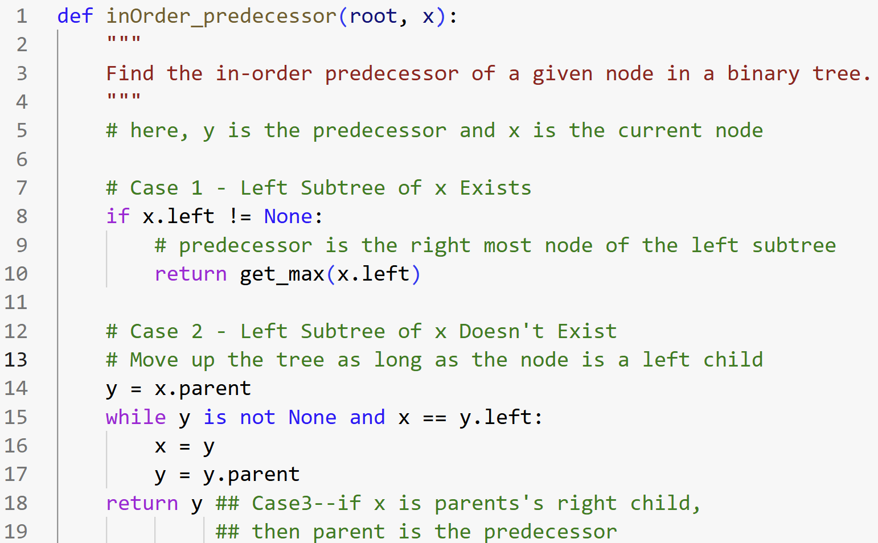
Predecessor
Binary trees Ch 12.2–3

Slide 15
Predecessor
find predecessor(17) find predecessor(23) find predecessor(19) find predecessor(76) find predecessor(9)
Binary trees Ch 12.2–3

Slide 16
Predecessor
find predecessor(17): [Case01]
Left sub-tree exists
Get the rightmost node (max value) of the left subtree.
Answer: 14
find predecessor(23): [Case01]
Left sub-tree exists
Get the rightmost node (max value) of the left subtree.
Answer: 19
Binary trees Ch 12.2–3

Slide 17
Predecessor
find predecessor(19): [Case01]
Left sub-tree exists
Get the rightmost node (max value) of the left subtree.
Answer: 18
find predecessor(76): [Case03]
Left sub-tree does not exist
right child of parent--Then, predecessor is the parent which is 72.
Answer: 72
Binary trees Ch 12.2–3

Slide 18
Predecessor
find predecessor(9): [Case02]
Left sub-tree does not exist
LOOP: left child of its parent--Then, start going to the parent as long as its the left child or y becomes Null.
- Here, x = current node, y=predecessor
- Step01: x(current)=9, y(predecessor)=12
- Step02: x(current)=12, y(predecessor)=17
- Step03: x(current)=17, y(predecessor)=50
- Step04: x(current)=50, y(predecessor)=None (y==None, loop will end)
Answer: None
Binary trees Ch 12.2–3

Slide 19
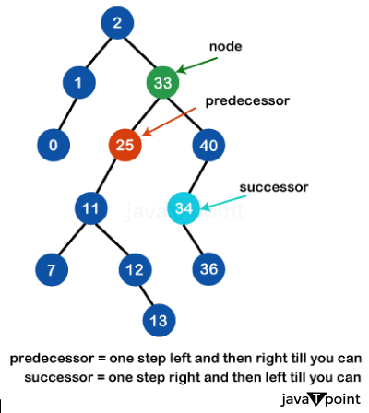
Successor and Predecessor
Image Source: https://www.javatpoint.com/inorder-predecessor-and-successor-in-a-binary-search-tree

Slide 20
Successor and Predecessor
IMPORTANT: REMEMBER THIS!!!!!
Largest element in BST does not have successor (None) Smallest element in BST does not have predecessor (None)
Image Source: https://www.javatpoint.com/inorder-predecessor-and-successor-in-a-binary-search-tree

Slide 21
Shortcut to Find Successor & Predecessor in BST
Step1: Perform inorder traversal → yields nodes in ascending order.
Step2: For a node x:
Successor = element immediately after x
Predecessor = element immediately before x
Image Source: https://www.javatpoint.com/inorder-predecessor-and-successor-in-a-binary-search-tree

Slide 22
Shortcut to Find Successor & Predecessor in BST
find successor(17)= 18 find successor(23)= 50 find successor(19)= 23 find successor(76)= None
In-order traversal: None 9 12 14 17 18 19 23 50 54 67 72 76 None
Image Source: https://www.javatpoint.com/inorder-predecessor-and-successor-in-a-binary-search-tree

Slide 23
Shortcut to Find Successor & Predecessor in BST
find predecessor(17)= 14 find predecessor(23)= 19 find predecessor(19)= 18 find predecessor(76)= 72 find predecessor(9)= None
In-order traversal: None 9 12 14 17 18 19 23 50 54 67 72 76 None
Image Source: https://www.javatpoint.com/inorder-predecessor-and-successor-in-a-binary-search-tree

Slide 24
Deletion
Deletion
Let z be the node to delete
Three basic cases
Case1: z has no children: delete z, set corresponding child pointer in z.p to NIL
Case2: z has one child y: Ensure the deleted node's child is connected to the deleted node's parent.
Case3: z has two children: replace z by either its
Inorder successor
Inorder predecessor
IMPORTANT: REMEMBER CASES!!!!!
Binary trees Ch 12.2–3

Slide 25
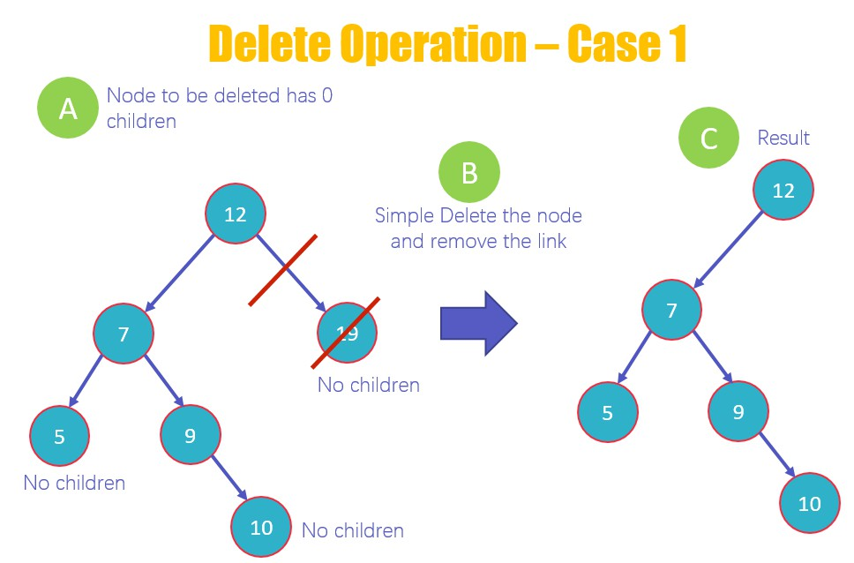
Deletion (Case01:If No Children (Leaf Node))
Image Source: https://www.guru99.com/binary-search-tree-data-structure.html

Slide 26
Deletion (Case01:If No Children (Leaf Node))

Slide 27
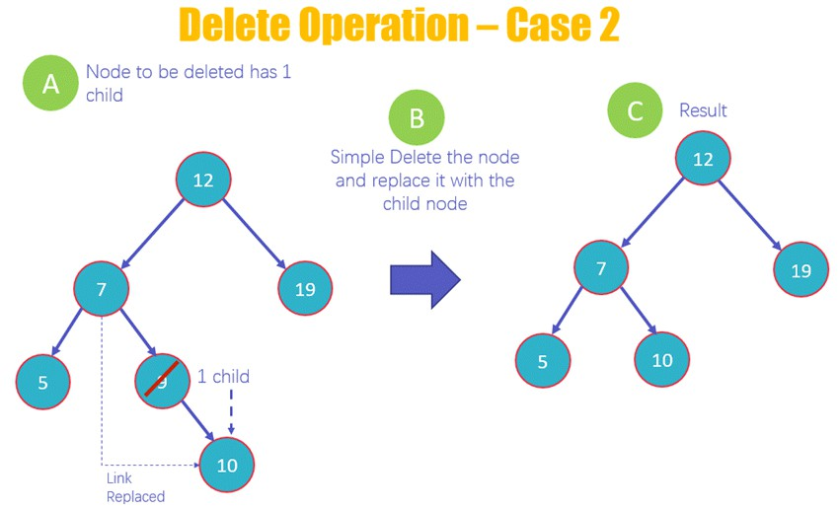
Deletion (Case02: If Only One Children exists)
Image Source: https://www.guru99.com/binary-search-tree-data-structure.html

Slide 28
Deletion (Case02: If Only One Children exists)

Slide 29
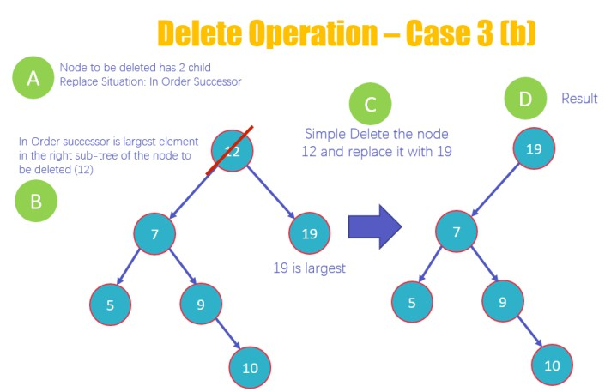
Deletion (Case03: If both Children exists)
Image Source: https://www.guru99.com/binary-search-tree-data-structure.html

Slide 30
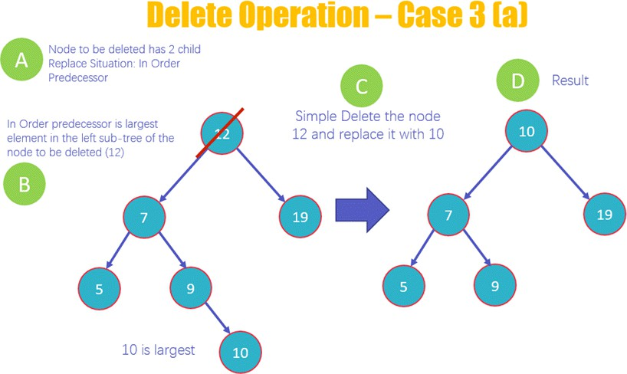
Deletion (Case03: If both Children exists)
Image Source: https://www.guru99.com/binary-search-tree-data-structure.html

Slide 31
Deletion (Case03: If both Children exists)

Slide 32
Try out Interactive Simulation by Visualgo.net (https://visualgo.net/en/bst)
Interactive simulations

Slide 33
The End

